Slide 1




Add company name here | MM/DD/YYYY
This presentation has live captioning
FINAL PROJECT
Digital System Design
NAME OF PROJECT:
PRESENTED BY:
PRESENTED TO:
Write here
Write here
Write here

Slide 2





Our team
09/10
Saddam Titanio Darmawan
Andika Mangaraja Nainggolan
Lando Akmalkane A.M
Benintya Farrel Armaya
2406450472
2406450333
2406450390
2406450346

Slide 3


03 | Introduction
04 | About Project
05 | Objective
06 | Tools Used
07 | Implementation
08 | Testing
09 | Results
10 | Analysis
Table of Contents

Slide 4

01
QPSK works by mapping incoming bits into in-phase (I), and quadrature (Q) components, which are then combine with cosine, and sine carriers
03/10
Introduction
02
CORDIC algorithm is used to efficiently generate sine, and cosine values using only shift, and add operations
03
QPSK (Quadrature Phase Shift Keying) are often used to transmit data efficiently using phase modulation, like WLANs/Wi-Fi, and WiMAX

Slide 5
08/10
About Project
This project is the implementation of an FPGA-based QPSK modulator using the CORDIC algorithm to process a binary data stream into a phase-modulated carrier signal. The input bits are grouped into 2-bit symbols, and mapped to QPSK constellation points. I and Q components are multiplied by orthogonal carriers, then summed to form the QPSK output signal. Then, CORDIC algorithm is used to efficiently generate sine, and cosine values using shift, and add operations

Slide 6


Tools Used
Objective
These are the tools used for this Project
Implement an FPGA-based QPSK modulator
Map bit-pairs into I/Q constellation points
Generate carrier signals using the CORDIC algorithm
Use a phase accumulator for continuous phase tracking
Perform I/Q mixing to produce the modulated output
Phyton 3
Vivado 2025.1
It is used to generate the micro-rotation angles in Hexadecimal format
It is used to make most of the VHD code

Slide 7
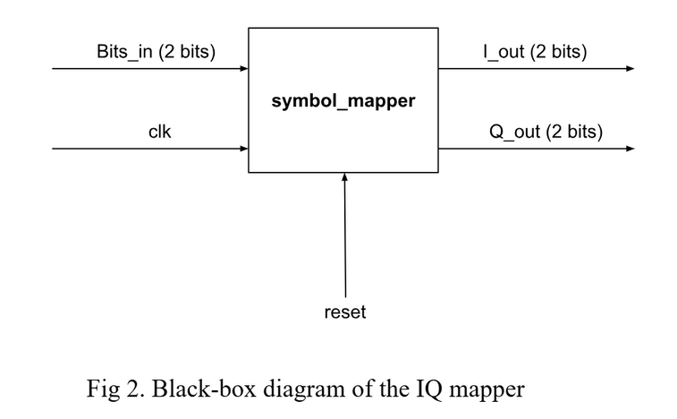
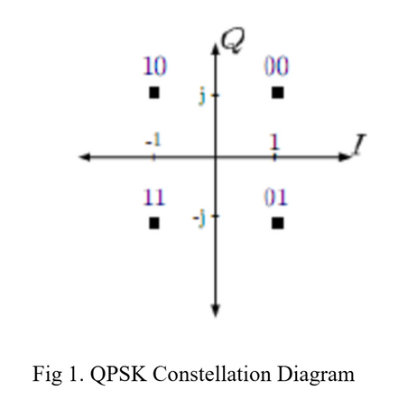
Implementations
QPSK modulator works by mapping the pairs of bits into one of the four possible symbols in the constellation diagram, as shown in the picture of the QPSK constellation diagram down left below. The purpose is to differentiate the pairs by applying different phase shifts to the carrier wave depending on the bit sequence.
That way, the receiver can look at the phase of the incoming signal and perform the correct decoding method to recover the original two bits. Typically, bits 00, 10, 11, and 10 will have a phase shift of 0°, 90°, 180°, and 270°, respectively. The first bit of the symbol determines the in-phase component, while the second bit determines the quadrature component. For instance, if the two bits were 00, the resulting symbol would be 1+1j.
The process diagram is shown in the black-box diagram of the IQ mapper, which is the picture bottom right. The outputs use two bits since the MSB will be used as the sign bit.

Slide 8
Implementations
These components are then multiplied by their respective carrier signals. By convention, the I signal is modulated with a cosine waveform, and the Q signal is modulated with a sine waveform. To generate the carrier signals, a phase accumulator will increment the phase by a fixed amount each clock cycle and feed the resulting phase angle into a CORDIC algorithm to produce the corresponding sine and cosine waveforms. The phase accumulator will count from 0 to 2N - 1 (mod 2N), where N is the width of the register.
The CORDIC algorithm fundamentally operates through a sequence of vector rotations. It rotates a vector with an initial magnitude by a specified angle using incremental micro-rotations. The accuracy of the CORDIC result increases with the number of iterations since each additional iteration tunes the rotation by a smaller micro-angle. The algorithm is derived from the general rotation transform equations:
x'=xcos(alpha)-ysin(alpha)
y'=xsin(alpha)+ycos(alpha)
Which these can be rearranged into
x'=cos(alpha)(x-ytan(alpha))
y'=cos(alpha)(y+xtan(alpha))
If the angles are chosen such that
tan(alpha)=2-i and therefore alpha_i = arctan(2-i),
The multiplication by the tangent term can be implemented using a right-shift operation since division by 2n in binary corresponds to shifting right by n bits. However, the computational process has not yet been entirely simplified since it still involves a cosine multiplication at each iteration.

Slide 9
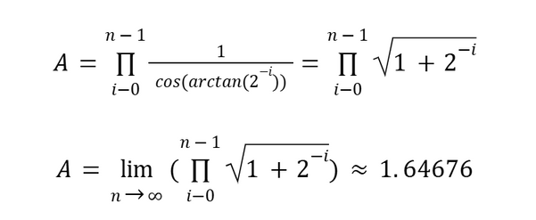
Implementations
To resolve this issue, the cosine multiplication can actually be factored out of the iterative process as long as we apply a “correction factor” at the very end. This is necessary because each iteration stretches the length of the vector and we need a correction factor called gain to revert the vector to its initial length. At iteration i, the vector gets scaled by 1/cos(arctan(2-i)). Thus the correction is given by:
The output of the CORDIC algorithm will be a signed 16-bit value. Thus, the gain that will be :
GAIN = (215 - 1)/1.64676 = 0x4DB7
Now that the cosine multiplications are no longer included during the iterative process, the CORDIC algorithm only involves shift, addition, and subtraction operations.
x_i+1=x_i - y_i 2-i
y_i+1=y_i + x_i 2-i

Slide 10
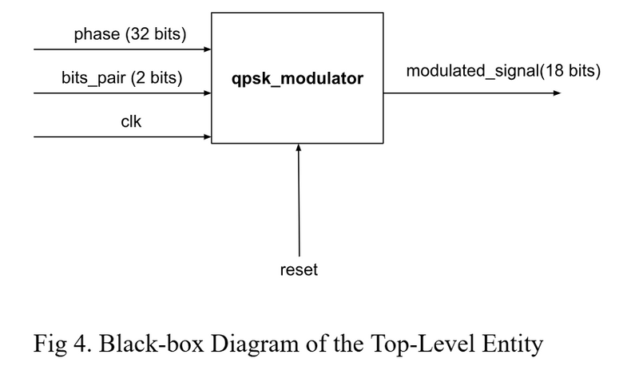
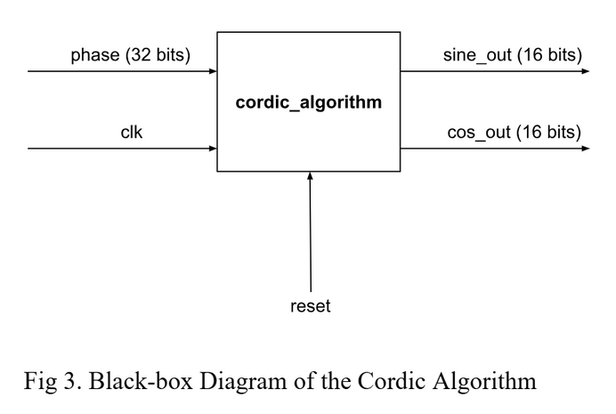
Implementations
The CORDIC micro-rotation angles are generated using a Python program. The set of angles will function as a lookup table that will be referred to for each iteration. Each angle is converted from radians to degrees and then scaled into 32-bit phase-accumulator units. It will print each value in the appropriate hexadecimal format so that it can be directly pasted into the VHDL script.
Once the cosine and sine carrier signals are generated, they will be multiplied by the value of the I and Q components, respectively. The resulting output will be 18 bits to prevent overflow since a multiplication between a 16-bit and a 2-bit value will at most yield an 18-bit value. Afterward, the two results are added to produce the final modulated signal. An n-bit adder is used to achieve this functionality, which consists of full adders generated using the for generate construct in VHDL. Finally, structural modeling is employed to interconnect all the lower-level components to produce the modulated signal based on the bit-pairs.

Slide 11
Module
Test Objective
Methodology
QPSK Mapper
The mapper correctly outputs the constellation symbol for every valid input bit-pair.
Provide all four possible bit-pair inputs: 00, 01, 10, 11
Check that the output matches the expected I/Q symbol mapping.
CORDIC Sine/Cosine Generator
The CORDIC algorithm produces reasonably accurate sine and cosine values for the given phase input.
Use a range of values within the 360° phase range
A Python script will be used to compute the RMS error of the cosine and sine values obtained using the CORDIC algorithm
Top-Level QPSK Modulator
Verify that the top-level integration of symbol mapping, phase accumulation, CORDIC carrier generation, and IQ mixing into a final modulated signal.
Provide all four possible bit-pair inputs of 00, 01, 10, 11.
Observe the final modulated waveform and confirm that each bit pair produces the correct phase-shifted carrier

Slide 12
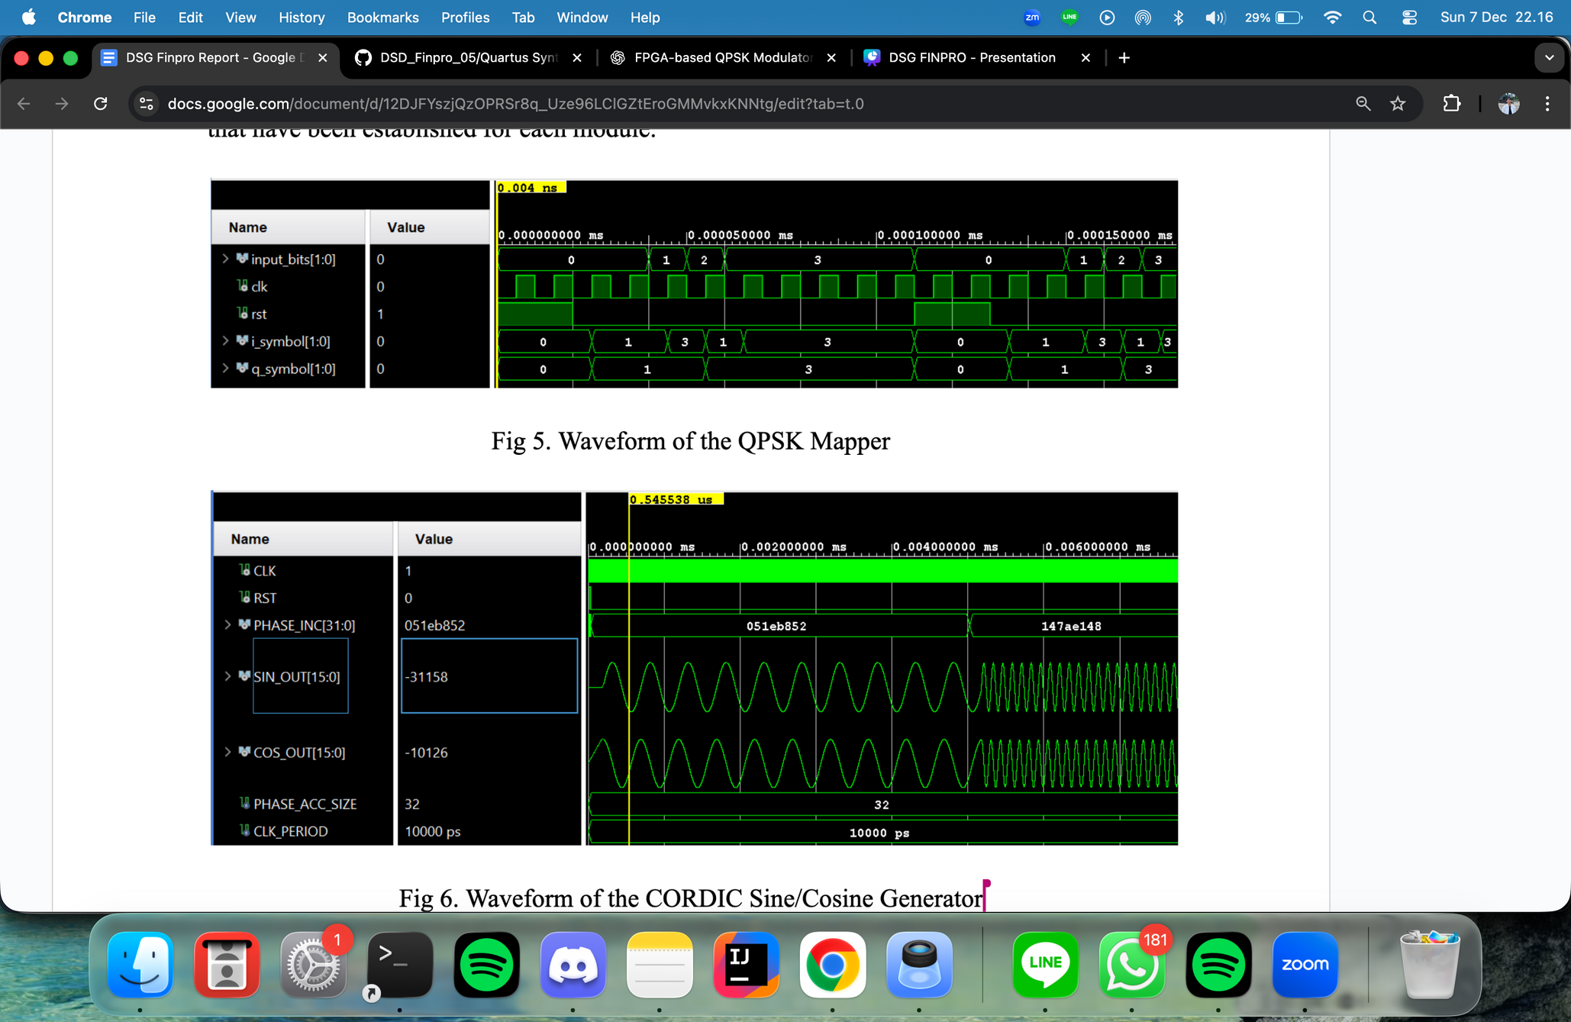
Results
Each module was evaluated using testbenches built to match the previously defined testing methodology, and the resulting outputs were recorded.
QSPK Mapper Waveform
CORDIC Generator Waveform

Slide 13
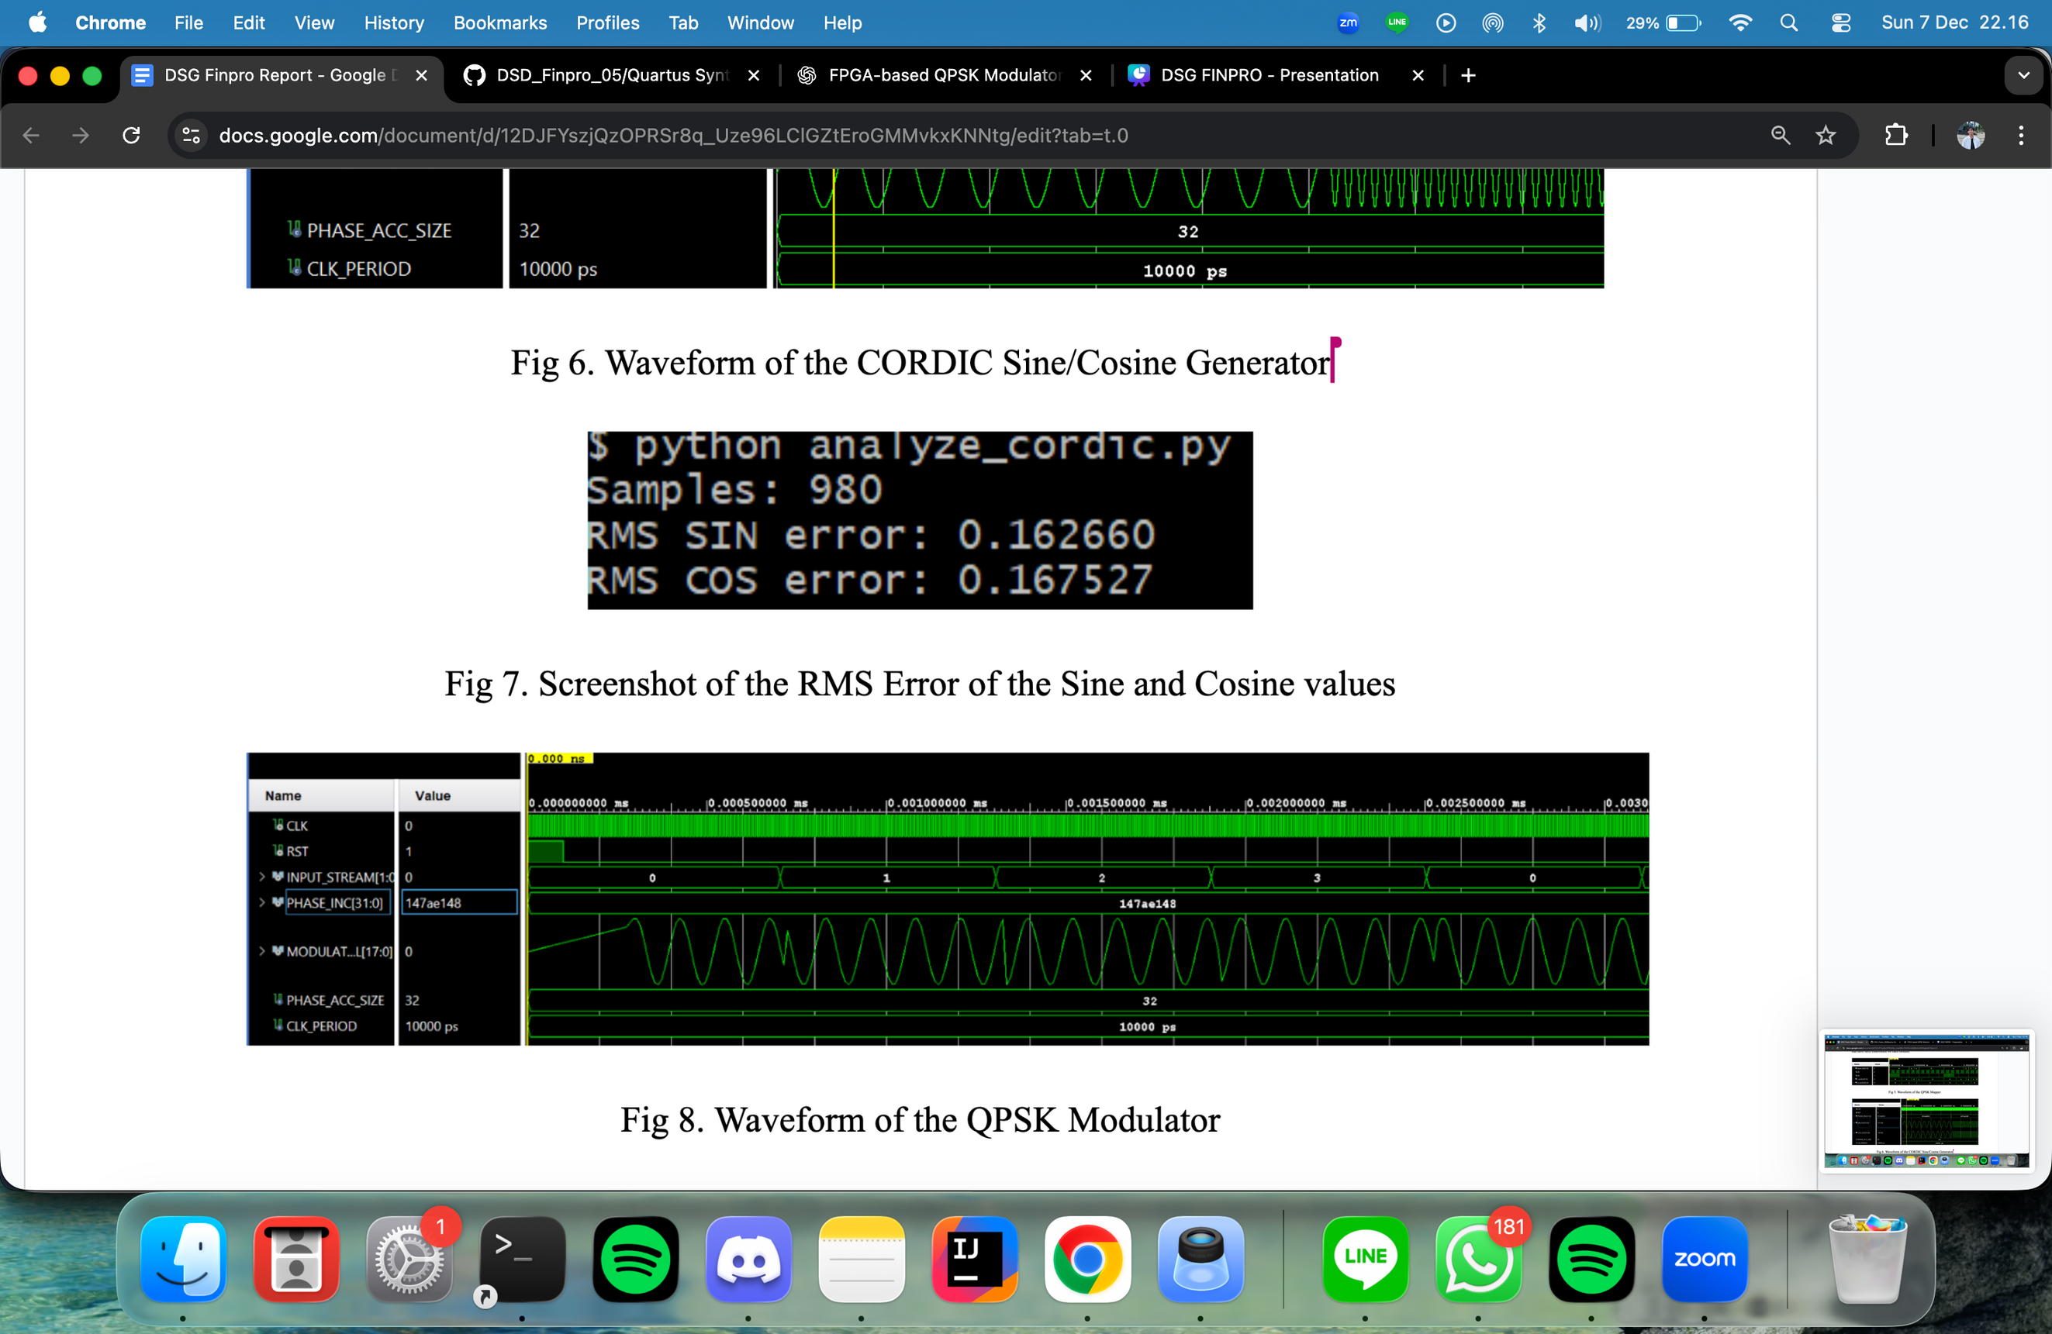
RMS error of SIn/Cosine values
QSPK Modulator

Slide 14
Analysis
The QPSK Mapper successfully produces the correct I and Q symbols for all tested bit-pair inputs, confirming proper constellation mapping. For example, an input of 00 generates I = 1 and Q = 1, while 01 produces the expected signed outputs for each component. The CORDIC sine and cosine generator also performs correctly, with waveforms clearly showing the required 90° phase difference, and higher carrier frequencies displaying shorter wavelengths as expected.
However, the measured RMS error of approximately 0.16–0.17 indicates that the CORDIC implementation, while functional, can still be optimized through improvements such as more iterations, wider bit-widths, or refined gain adjustments. At the top level, all modules integrate properly, with the I/Q mixer generating the correct products and the final signal exhibiting the expected four QPSK phase states. The combined waveform behavior confirms that the full modulation chain operates as intended.

Slide 15
10/10
Thank you
CONTACT US
E-mail
hello@reallygreatsite.com
Social Media
@reallygreatsite
Phone
+123-456-7890
Address
123 Anywhere St., Any City, ST 12345
www.reallygreatsite.com

